Slide 1
4.1.5. a – Sex-linked inheritance
TEXT –
11.3 SEX-LINKED INHERITANCE

Slide 2
Learning intention Success criteria
predict frequencies of genotypes and phenotypes using data from probability models (including frequency histograms and Punnett squares) and by taking into consideration patterns of inheritance for the following types of alleles: Sex linked.
Give an expected frequencies of genotypes and phenotypes using data from probability models and by taking into consideration patterns of inheritance for the following types of alleles: Sex linked.

Slide 3
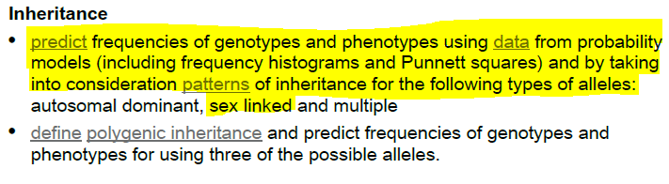
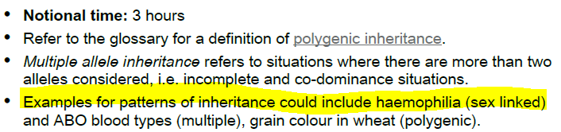
Syllabus check:
By the end of the lesson you should be able to…
NOTE SPECIFICALLY….

Slide 4
Sex-linked inheritance
sex-linked genes
genes on the X chromosome
carrier
an individual (female
in humans) who is heterozygous for a sex-linked gene or an individual who is infected by a pathogen but does not display the symptoms
The sex of an individual is determined by specific sex chromosomes. All other chromosomes are termed autosomes. In humans, and in some other species, the female has two X chromosomes and the male has an X and a Y chromosome.
Sex-linked genes
Genes found on the X chromosome are termed sex-linked genes. An equivalent allele is not carried on the Y chromosome. In male offspring (XY), the X chromosome must come from the mother and the Y chromosome must come from the father. Since there is only one X chromosome, there is only one possible set of genes for that chromosome. If the X chromosome in a male has an allele for a recessive trait, the trait will appear in the phenotype automatically. In contrast, females have two X chromosomes and therefore need two copies of the recessive trait allele before it is expressed in the phenotype. A heterozygous female for a sex-linked recessive gene is called a carrier .

Slide 5
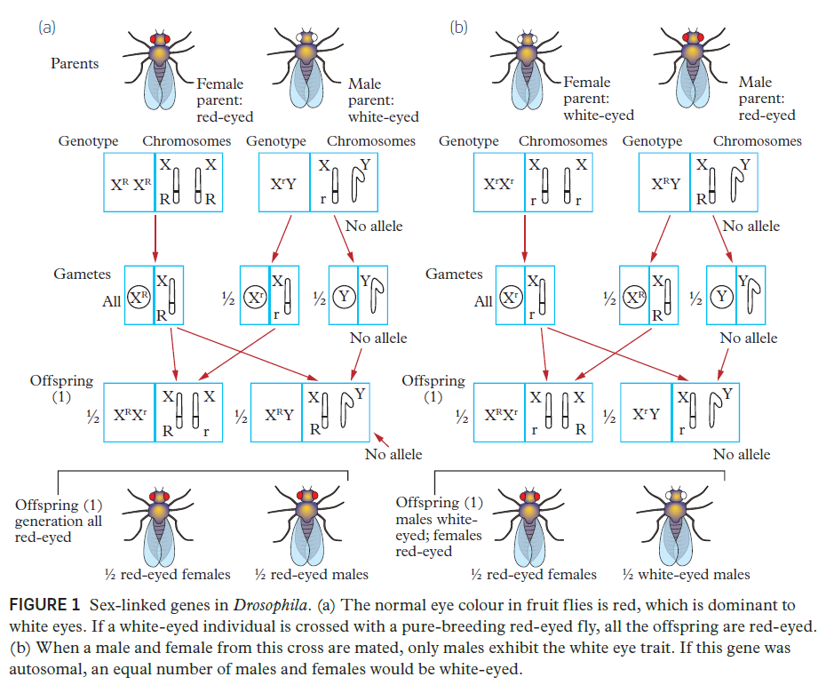
Sex-linked gene example from Drosophila fruit flies

Slide 6
Example of Sex-linked inheritance
Haemophilia is a group of disorders in which the blood does not clot normally. Blood clotting involves a series of chemical reactions in which each reaction depends upon a specific protein factor in the blood. The most common form of haemophilia results from the absence of one of these proteins. The gene for this protein is carried on the X chromosome. Haemophiliacs may bleed to death with even minor injuries. Most people who have been diagnosed with haemophilia are now provided with the missing protein factor (produced through a genetically modified bacterium). This treatment does not prevent the haemophilia allele being passed on to the offspring.
A classic example of haemophilia is that of the British royal family. Neither Queen Victoria nor Prince Albert had the disease, but their descendants did, indicating that the allele on the X chromosome came from Queen Victoria (carrier). Since none of Queen Victoria’s predecessors were known to exhibit the disease, it has been hypothesised that this recessive trait allele arose in her as a result of a mutation.
haemophilia
a group of disorders in
which the blood does
not clot normally

Slide 7
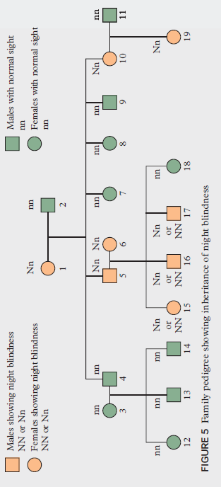


Slide 8
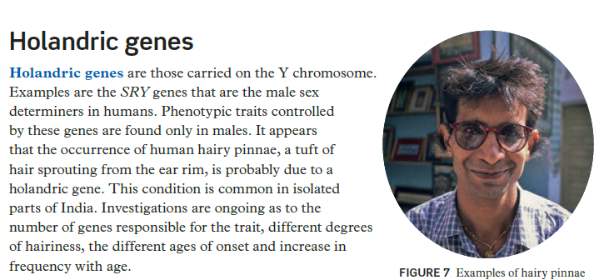
holandric genes
genes found on
a vertebrate Y
chromosome

Slide 9
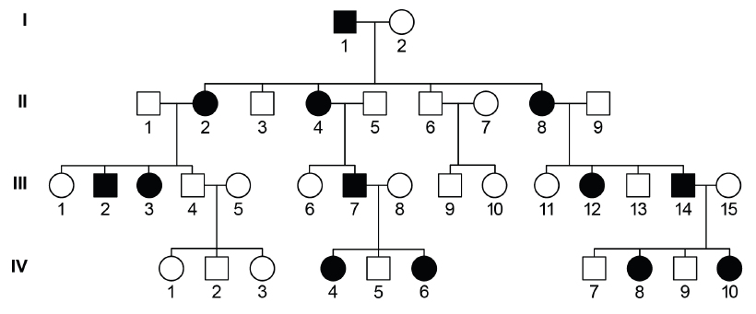
Exit ticket: A. Predict frequencies of genotypes and phenotypes using data from probability models (including frequency histograms and Punnett squares) and by taking into consideration patterns of inheritance for the following types of alleles: Sex linked.
SO MOCKEXAM 2020 SA 1 (4.1.5 a) QUESTION 29 (4 marks)
The inheritance of Fragile X syndrome is X-linked dominant. The pedigree below shows the occurrence of the syndrome in one family with individual IV-4 being heterozygous for Fragile X syndrome. Affected individuals are shaded.
Predict the probability of an offspring being male with the disorder if individual IV-4 mates with an individual without the syndrome. Show your reasoning.

Slide 10
Further research
1. Review the basics of Sex-linked Inheritance by watching the Amoeba Sisters video 'Punnett Squares and Sex-Linked Traits': https://www.youtube.com/watch?v=h2xufrHWG3E
2. Review of Sex-linked genes on X chromosomes by watching Robin Ball ‘Secrets of the X chromosome” (TED-Ed)
https://www.youtube.com/watch?v=veB31XmUQm8

